Slide 1
Nomenclature of Inorganic Compounds
Chapter 6

Slide 2
Chemical Formulas
AxByCz
Elemental Symbol
Number of atoms

Slide 5
Inorganic Nomenclature

Slide 6
Nomenclature I
Binary ionic nomenclature

Slide 7
Ions
atoms or groups of atoms that have gained or lost electrons.
cation -- positive ion
anion -- negative ion

Slide 8
Ionic Compounds
Neutral compounds which are formed when anions and cations come together in ratios that balance the positive and negative charges. (Form formula units)

Slide 9
Common monatomic ions
H⁺
Li⁺ Be⁺² N⁻³ O⁻² F⁻
Na⁺ Mg⁺² Al⁺³ P⁻³ S⁻² Cl⁻
K⁺ Ca⁺² Zn⁺² As⁻³ Se⁻² Br⁻
Rb⁺ Sr⁺² Ag⁺ Cd⁺² Te⁻² I⁻
Cs⁺ Ra⁺²

Slide 10
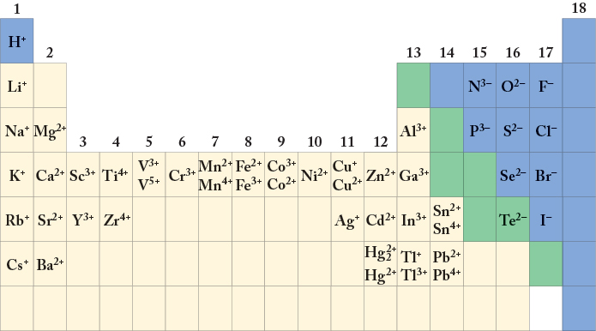
Notes:
FIGURE 2.17 The most common charges on the ions of some common elements. With the representative elements (groups 1, 2, and 13–18), all the ions in the group typically have the same charge. All the ions shown are made of only one atom except for the mercury ion Hg₂²⁺.

Slide 11
Cation names = element name
Na⁺ sodium ion
Ca²⁺ calcium ion
Co³⁺ cobalt(III) ion
Co²⁺ cobalt(II) ion
for transition metals or other metals with variable oxidation states use roman numerals to designate charge.

Slide 12
Anion names = elementide ion
N³⁻ nitrogen ⇒ nitride ion
O²⁻ oxygen ⇒ oxide ion
S²⁻ sulfur ⇒ sulfide ion
Cl⁻ chlorine ⇒ chloride ion

Slide 13
Compound formation
Ions will combine in such a way as to neutralize charges

Slide 14
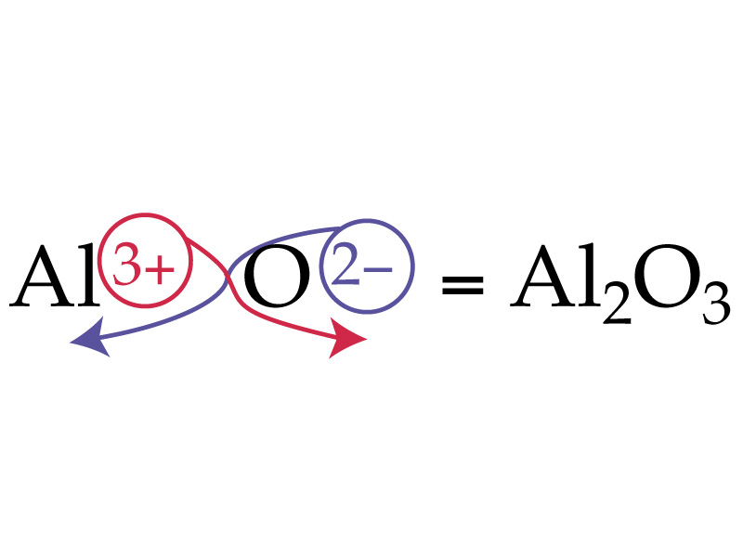

Slide 15
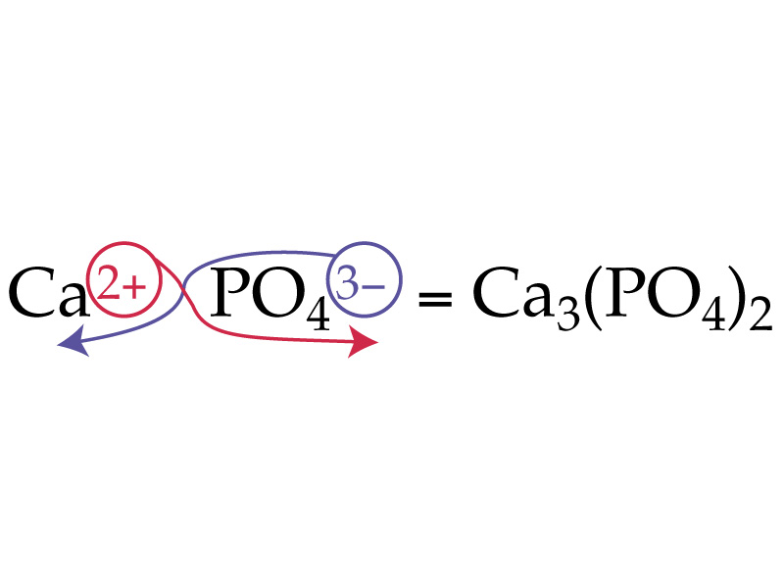

Slide 16
Formula Unit
The smallest representative unit of an ionic compound.

Slide 17
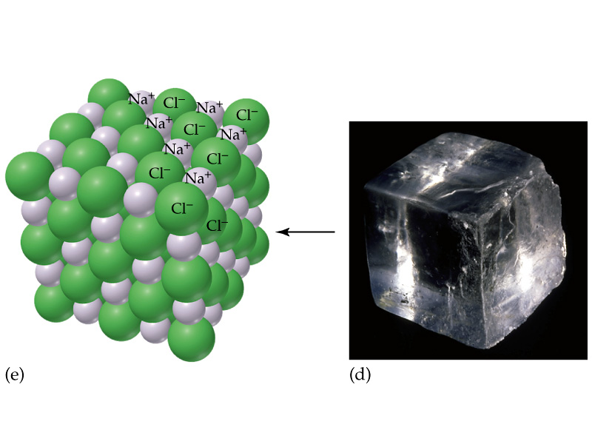

Slide 18
Cations with one oxidation state
Cations with multiple oxidation states

Slide 19
calcium + bromine
Ca⁺² + Br⁻¹
CaBr₂
calcium bromide

Slide 20
silver + oxygen
⇒ Ag⁺ + O⁻²
⇒ Ag₂O
silver oxide

Slide 21
potassium + chlorine
⇒ K⁺ + Cl⁻
⇒ KCl
potassium chloride

Slide 22
aluminum + oxygen
⇒ Al⁺³ + O⁻²
⇒ Al₂O₃
aluminum oxide

Slide 23
Name to Formula
Magnesium chloride
Cadmium nitride
Potassium bromide
Rubidium oxide
Silver sulfide
MgCl₂
Cd₃N₂
KBr
Rb₂O
Ag₂S

Slide 24
Formula to Name
Na₃N
FeCl₃
Ca₃P₂
CdO
LiI
sodium nitride
iron(III) chloride
calcium phosphide
cadmium oxide
lithium iodide

Slide 25
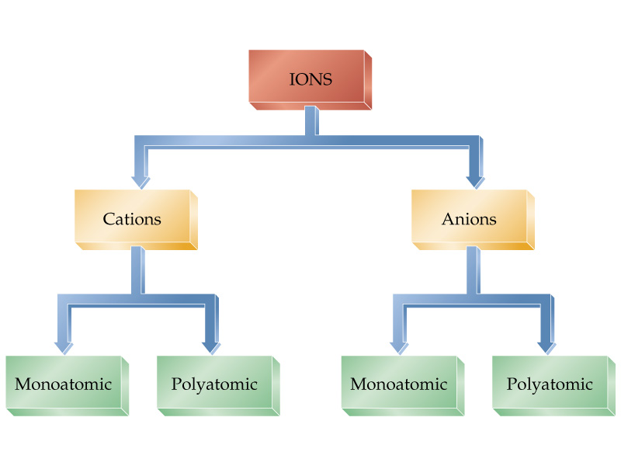

Slide 26
Latin names for cations
Copper(I) = cuprous = Cu⁺
Copper(II) = cupric = Cu⁺²
Iron(II) = ferrous = Fe⁺²
Iron(III) = ferric Fe⁺³
Tin(II) = stannous = Sn⁺²
Tin(IV) = stannic = Sn⁺⁴

Slide 27
Mercury
Remember—
Mercury (I) exists only as Hg₂⁺²
Mercury (II) is Hg⁺²

Slide 28
Acid Nomenclature
Binary Acids
HX hydrogen _____ide
becomes
Hydro______ ic acid

Slide 29
HCl(g) hydrogen chloride
HCl (aq) hydrochloric acid
H₂S(g) hydrogen sulfide
H₂S(aq) hydrosulfuric acid
HCN(g) hydrogen cyanide
HCN(aq) hydrocyanic acid

Slide 30
Binary Covalent Nomenclature

Slide 31
Name as
_____ element 1 _____ element 2 ide
↑ ↑
prefix telling number of each type of atom at arrows
Generally more metallic atom listed first
CO₂ carbon dioxide
Br₃O₈ tribromine octaoxide

Slide 32
Prefixes
mono 1
di 2
tri 3
tetra 4
penta 5
hexa 6
hepta 7
octa 8
nona 9
deca 10

Slide 33
mono prefix used only for second element.
For example
NO nitrogen monoxide CO carbon monoxide

Slide 34
Formula to name
NI₃
BrCl₅
N₂F₄
SO₃
I₂O₅
XeF₄
Nitrogen triiodide
Bromine pentachloride
Dinitrogen tetrafluoride
Sulfur trioxide
Diiodine pentoxide
Xenon tetrafluoride

Slide 35
Name to formula
Chlorine monoxide
Carbon tetrabromide
Xenon hexafluoride
Diboron tetrachloride
Diphosphorous pentasulfide
Tetraphosphorous triselenide
ClO
CBr₄
XeF₆
B₂Cl₄
P₂S₅
P₄Se₃

Slide 36
Nomenclature 2
Ternary “ate” ions

Slide 37
Ternary “ate” anions
Ions inside Mississippi
contain 4 oxygen atoms.
Ions outside Mississippi
contain 3 oxygen atoms
look at charge trends

Slide 38
Formula to name
Ca(ClO₃)₂
Na₂SO₄
Mg₃₍PO₄)₂
Al(BrO₃)₃
calcium chlorate
sodium sulfate
magnesium phosphate
aluminum bromate

Slide 39
Name to formula
lithium selenate -
potassium iodate
aluminum carbonate
calcium borate
cuprous sulfate
Li₂SeO₄
KIO₃
Al₂(CO₃)₃
Ca₃(BO₃)₂
Cu₂SO₄

Slide 40
Nomenclature 3 +
Ternary ions – ite, per-ate, hypo-ite

Slide 41
Ite anions
Subtract one oxygen from ate anion and leave charge the same

Slide 42
Group III (-3) | Group IV (-2) | Group V (-3 except N) | Group VI (-2) | Group VII (-1)
Borate BO₃⁻³ | Carbonate CO₃⁻² | Nitrate NO₃⁻¹ Nitrite NO₂⁻¹
 |  | Phosphate PO₄⁻³ Phosphite PO₃⁻³ | Sulfate SO₄⁻² Sulfite SO₃⁻² | Chlorate ClO₃⁻¹ Chlorite ClO₂⁻¹
 |  | Arsenate AsO₄⁻³ Arsenite AsO₃⁻³ | Selenate SeO₄⁻² Selenite SeO₃⁻² | Bromate BrO₃⁻¹ Bromite BrO₂⁻¹
 |  |  | Tellurate TeO₄⁻² Tellurite TeO₃⁻² | Iodate IO₃⁻¹ Iodite IO₂⁻¹

Slide 43
Name to Formula
Strontium sulfite
Beryllium carbonate
Aluminum oxide
Lithium nitrite
Barium sulfate
SrSO₃
BeCO₃
Al₂O₃
LiNO₂
BaSO₄

Slide 44
Formula to name
K₃PO₃
Mg₃(BO₃)₂
Al(ClO₂)₃
Al(IO₃)₃
potassium phosphite
magnesium borate
aluminum chlorite
aluminum iodate

Slide 45
Hypo -- ites and per -- ates
Hypo -- ite = ite - 1 oxygen
Per -- ate = ate + 1 oxygen
These exist only for the halogens.
perchlorate ClO₄⁻¹
chlorate ClO₃⁻¹
chlorite ClO₂⁻¹
hypochlorite ClO⁻¹
Same pattern for bromine and iodine.

Slide 46
NaBrO
Mg(NO₃)₂
Na₂SO₃
LiIO₄
Mg(ClO₃)₂
sodium hypobromite
Magnesium nitrate
sodium sulfite
lithium periodate
magnesium chlorate

Slide 47
Formula to name
aluminum perbromate
calcium hypoiodite
potassium nitrite
strontium hypochlorite
Al(BrO₄)₃
Ca(IO)₂
KNO₂
Sr(ClO)₂

Slide 48
Formula to Name
Mn(NO₂)₃
Cu₂O
AlPO₄
V(BrO)₅
Fe₂(CO₃)₃
Manganese(III) nitrite
Copper(I) oxide
or cuprous oxide
Aluminum phosphate
Vanadium(V) hypobromite
Iron(III) carbonate
or ferric carbonate

Slide 49
Name to Formula
Stannic sulfate
Titanium(II) arsenate
Mercury(I) chloride
Copper(II) phosphate
Ferrous sulfide
Sn(SO₄)₂
Ti₃(AsO₄)₂
Hg₂Cl₂
Cu₃(PO₄)₂
FeS

Slide 50
Ions to Memorize
NH₄⁺¹ ammonium ion
OCN⁻¹ cyanate ion
CrO₄⁻² chromate ion
Cr₂O₇⁻² dichromate ion
MnO₄⁻¹ permanganate ion
CN⁻¹ cyanide ion
C₂H₃O₂⁻¹ acetate ion C₂O₄⁻² oxalate ion
OH⁻¹ hydroxide ion
O₂⁻² peroxide ion

Slide 51
Sulfur compounds
When an oxygen atom in an ion is replaced by a sulfur atom the prefix thio is added to the name.
OCN⁻¹ cyanate SCN⁻¹ thiocyanate
SO₄⁻² sulfate S₂O₃⁻² thiosulfate

Slide 52
Name to formula
Rubidium thiosulfate
Calcium peroxide
Sodium dichromate
Ammonium perchlorate
Potassium permanganate
Aluminum cyanide
Rb₂S₂O₃
CaO₂
Na₂Cr₂O₇
NH₄ClO₄
KMnO₄
Al(CN)₃

Slide 53
Formula to name
Na₂CrO₄
(NH₄)₂SO₄
MnC₂O₄
Al(C₂H₃O₂)₃
Ba(OH)₂
KSCN
Sodium chromate
Ammonium sulfate
Manganese(II) oxalate
Aluminum acetate
Barium hydroxide
Potassium thiocyanate

Slide 54
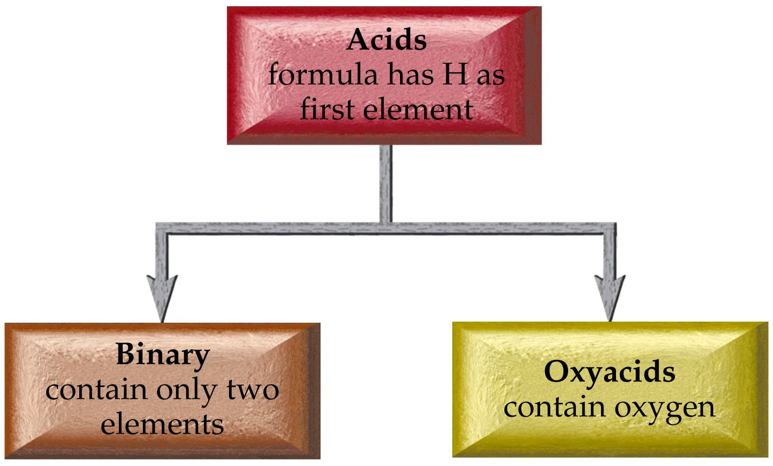

Slide 56
Oxyacid Nomenclature
Hydrogen ___ate → ___ic acid
Hydrogen ___ite → ___ous acid
Hydrogen per __ate → per__ic acid
Hydrogen hypo__ite →hypo__ous acid

Slide 57
H₂SO₄
H₂SO₃
H₂CO₃
HClO
H₂TeO₃
HBrO₄
sulfuric acid
sulfurous acid
carbonic acid
hypochlorous acid
tellurous acid
perbromic acid

Slide 58
Acid salt nomenclature
HX-? Hydrogen anion name
H₂X-? Dihydrogen anion name
Sometimes use the prefix bi to indicate the presence of one H attached to an anion

Slide 59
HCO₃⁻¹ hydrogen carbonate or bicarbonate
HS⁻¹ hydrogen sulfide or bisulfide
HSO₄⁻¹ hydrogen sulfate or bisulfate

Slide 60
HPO₄⁻² hydrogen phosphate
H₂PO₃⁻¹ dihydrogen phosphite

Slide 61
Hydrates
Some salts precipitate with water molecules in the crystal lattice. These are called hydrates.
Name as compound name ___hydrate
Where the prefix tells the number of water molecules in the crystal

Slide 62
NaNO₃·4H₂O sodium nitrate tetrahydrate
K₃PO₄·7H₂O potassium phosphate heptahydrate
MgO·5H₂O magnesium oxide pentahydrate

Slide 63
